Slide 1

The Karnaugh map (K-map for short), is a method to simplify Boolean Algebra expressions. The Karnaugh map reduces the need for extensive calculations.
A Karnaugh map (K-map) is a pictorial method used to minimize Boolean expressions without having to use Boolean algebra theorems and equation manipulations. A K-map can be thought of as a special version of a Truth Table
Using a K-map, expressions with two to four variables are easily minimized. Expressions with five to six variables are more difficult but achievable, and expressions with seven or more variables are extremely difficult (if not impossible) to minimize using a K-map.

Slide 2

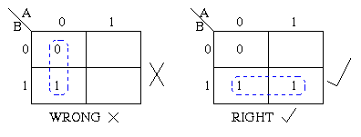
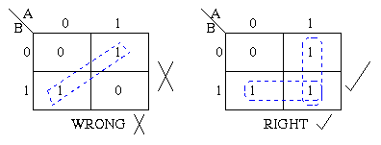
The Karnaugh map uses the following rules for the simplification of expressions by grouping together adjacent cells containing ones .
Groups may not include any cell containing a zero
Groups may be horizontal or vertical, but not diagonal.

Slide 3
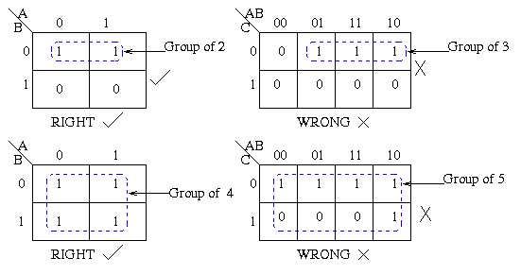
Groups must contain 1, 2, 4, 8, or in general 2^{n} cells.
That is if n = 1, a group will contain two 1's since 2¹ = 2.
If n = 2, a group will contain four 1's since 2² = 4.

Slide 4
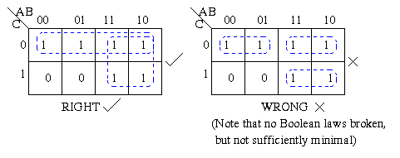
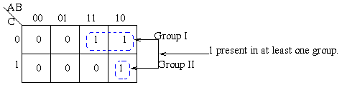
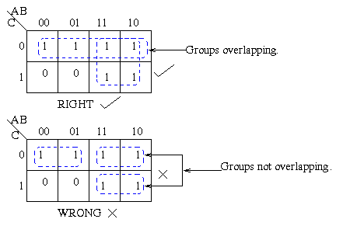
Each group should be as large as possible.
Each cell containing a one must be in at least one group.
Groups may overlap.

Slide 5
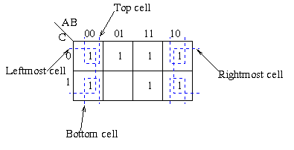
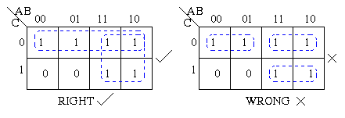
Groups may wrap around the table. The leftmost cell in a row may be grouped with the rightmost cell and the top cell in a column may be grouped with the bottom cell.
There should be as few groups as possible, as long as this does not contradict any of the previous rules.

